Slide 1

Note: The data and information in this document is reflective of a hypothetical situation and client. This document is to be used for KPMG Virtual Internship purposes only.
Sprocket Central Pty Ltd
Data analytics approach
[Division Name] - [Engagement Manager], [Senior Consultant], [Junior Consultant]

Slide 2
Note: The data and information in this document is reflective of a hypothetical situation and client. This document is to be used for KPMG Virtual Internship purposes only.
Agenda
Introduction
Data Exploration
Model Development
Interpretation

Slide 3
Note: The data and information in this document is reflective of a hypothetical situation and client. This document is to be used for KPMG Virtual Internship purposes only.
Introduction
Analyze new customers:
Factors need to analyze in new customers:
Age distributions
Bike purchases in past 3 years
Job industry category
car puchases in each state

Slide 4
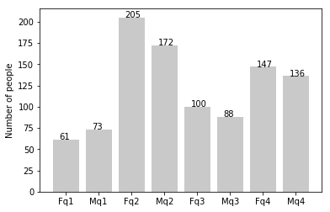
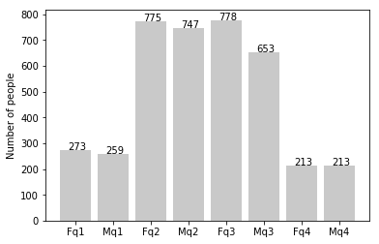
Note: The data and information in this document is reflective of a hypothetical situation and client. This document is to be used for KPMG Virtual Internship purposes only.
Data Exploration
Age Distribution:
Here we can see that our new customers are majorly from the age group og 25-48 years.
Their is a very big drop of customers from the age of group 48-59 years.
Well the percentage of people under 25 have not changed.
q1: Under 25; q2: 25 to 48; q3: 48 to 59; q4: Over 59

Slide 5
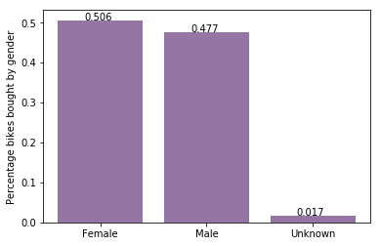
Note: The data and information in this document is reflective of a hypothetical situation and client. This document is to be used for KPMG Virtual Internship purposes only.
Model Development
Bike purchases in three years:
percentage of new customers are mostly females.
So we should advertise more towards female customers.
.

Slide 6
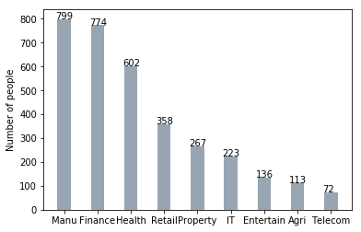
Note: The data and information in this document is reflective of a hypothetical situation and client. This document is to be used for KPMG Virtual Internship purposes only.
Interpretation
Job industry category:
Our new customers are mostly from manufacturing and finance sector.
We should try to advertise in such a way so that other sector may relate it and get attracted.
Place any supporting images, graphs, data or extra text here.

Slide 7
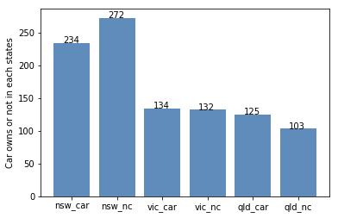
Note: The data and information in this document is reflective of a hypothetical situation and client. This document is to be used for KPMG Virtual Internship purposes only.
Interpretation
car purchases:
NSW car should be consider since the number of customer do not own car is more than that own.
Qld is own more so we need to find the flaws in that and should implement in our model so that customer gets attracted to the bike features more.
Place any supporting images, graphs, data or extra text here.

Slide 8
Note: The data and information in this document is reflective of a hypothetical situation and client. This document is to be used for KPMG Virtual Internship purposes only.
Appendix

Slide 9
Note: The data and information in this document is reflective of a hypothetical situation and client. This document is to be used for KPMG Virtual Internship purposes only.
Appendix
This is an optional slide where you may place any supporting items.

